Slide 1
STATFLO PARTNERSHIP PROPOSAL
LEADREACHER + STATFLO
Qualified outreach
integration
Turn approved Statflo audiences into personalized, reviewable outreach at scale.
Each platform does what it does best.
SMART LISTS
PERSONALIZED VIDEO
COMBINED REPORTING
Statflo owns customer records and compliant conversations. LeadReacher handles audience intelligence, personalized outreach and campaign reporting.
LeadReacher + Statflo integration proposal

Slide 2
01 | PROPOSED WORKFLOW
PROPOSED STATFLO INTEGRATION
Start with an approved Smart List.
PROPOSED PILOT FLOW
A practical pilot that adds LeadReacher audience intelligence and personalization without changing who owns the customer relationship.
01
Approved Statflo Smart List
Customer-approved starting audience
✓
Statflo remains the system of record
LeadReacher preparation
Customer records, assignments and compliant conversations stay in Statflo.
02
Audience, messaging and personalized video
03
User review
✓
LeadReacher prepares the outreach
Approve content, audience and eligible channels
Relevant audiences, personalized messaging and video are prepared for review.
04
Campaign delivery
Personalized or macro-level outreach
✓
Approval comes before launch
New prospect outreach remains subject to consent, channel and jurisdictional rules.
Combined reporting
05
Outcomes and opt-outs returned to Statflo
LeadReacher + Statflo | proposed Smart List pilot

Slide 3
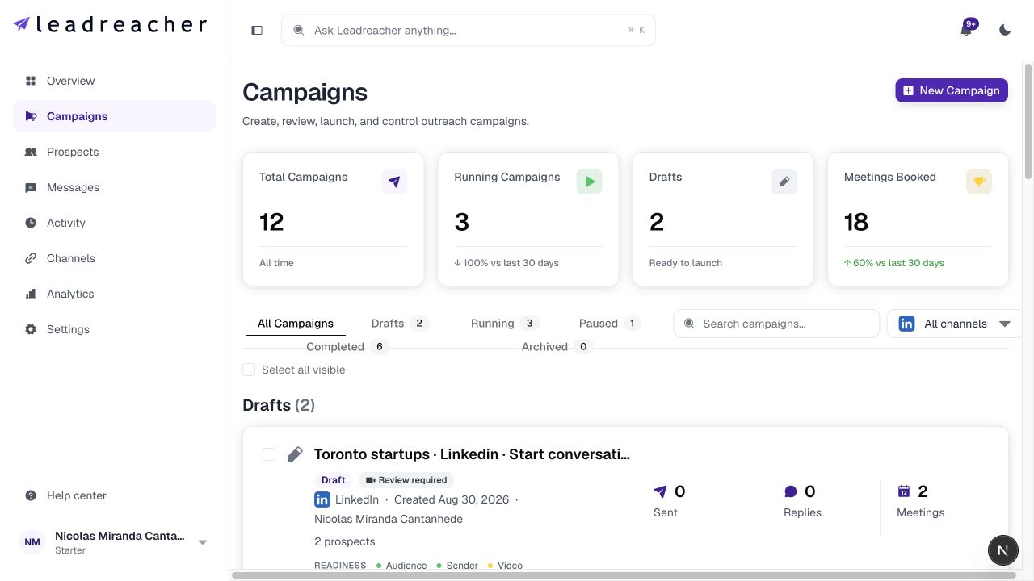
02 | CURRENT CAPABILITY
CURRENT LEADREACHER PRODUCT
Campaign operations already exist.
LeadReacher already supports the campaign workflow that would power the proposed Statflo integration.
✓
Prepare and review campaigns
Drafts and readiness checks keep the work visible before launch.
✓
Support multiple outreach channels
Delivery can be matched to the audience and eligible channel.
✓
Track campaign outcomes
Sent messages, replies and meetings stay connected to the campaign.
CURRENT PRODUCT SCREEN
The Statflo Smart List connection is proposed. The campaign controls shown here are available today.
LeadReacher + Statflo | existing campaign capability

Slide 4
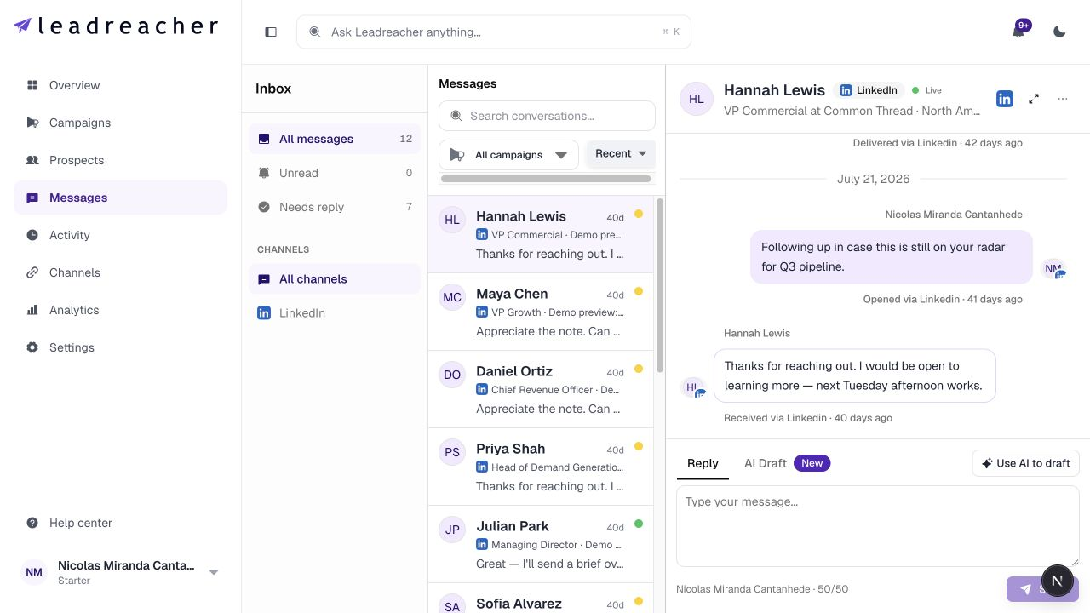
03 | CURRENT CAPABILITY
CURRENT LEADREACHER PRODUCT
Conversation management already exists.
LeadReacher can surface replies with the person, channel and campaign context needed for follow-up.
✓
Replies stay visible
Teams can see who replied and which campaign started the conversation.
✓
Context stays attached
The contact, channel and message history remain together.
✓
Statflo owns the customer conversation
The proposed integration would return relevant activity to Statflo for compliant follow-up.
CURRENT PRODUCT SCREEN
Personalized video inside Statflo is proposed. The conversation view shown here is available today.
LeadReacher + Statflo | existing conversation capability

Slide 5
04 | BUSINESS MODELS
TWO WAYS TO START
Two ways to integrate.
Both options add differentiated outreach capability while keeping Statflo at the centre of the customer relationship.
MODEL 1
MODEL 2
Dedicated outreach module
Additional contact channel
The enterprise outreach engine
The utility layer
A native LeadReacher module inside Statflo for Smart Lists, audience expansion, personalized video, bulk campaigns and reporting.
An Outreach action on each Statflo contact for advanced single-contact messaging and video, without bulk audience tools.
Best for platform-wide capability
Best for a fast, low-friction launch
Tiered enterprise fee
Per use or pay as you go
LeadReacher + Statflo | integration models

Slide 6
05 | RECOMMENDED PILOT
START SMALL, PROVE VALUE
A focused Smart List pilot.
A controlled first step that tests audience quality, personalization, approvals and reporting before a deeper rollout.
01
02
03
04
Approved Smart List
Personalized campaign
Review before launch
Outcomes returned
Statflo provides a customer-approved audience.
LeadReacher prepares messaging and video.
The user approves content, audience and channels.
Results and opt-outs come back for combined reporting.
BEST LONG-TERM CONNECTION
Confirm support for contacts, Smart Lists, campaigns, rep assignments, opt-outs, conversation events and deep links. Needed: sandbox, API and webhook documentation, rate limits and data-retention requirements.
Use Statflo’s partner API where available, with CSV or SFTP as a practical fallback.
LeadReacher + Statflo | proposed pilot

